Slide 1
New Twists on your Favorite Math Circle Activity
Angie Hodge-Zickerman & Cindy York

Slide 2
New Twists on your Favorite Math Circle Activity
Angie Hodge-Zickerman & Cindy York

Slide 3
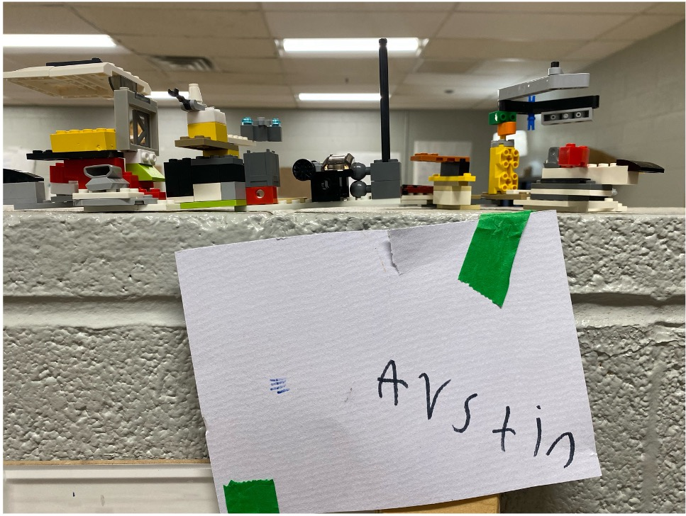
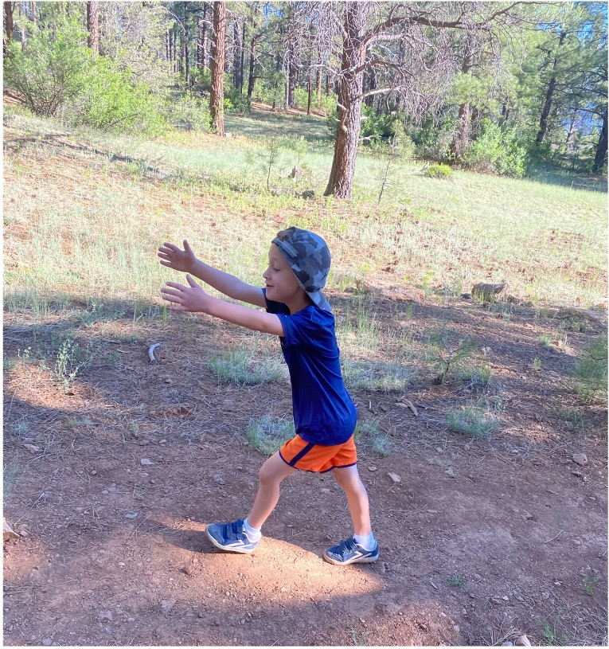
Angie.Hodge@nau.edu

Slide 4
About Cindy…
cindy.york@niu.edu

Slide 5
OPENING PUZZLE
Arrange the numbers from 1 to 15 in a row so that the sum of any two adjacent numbers is a perfect square.
1 | 2 | 3 | 4 | 5 | 6
7 8 9
10
11
12 | 13 | 14 | 15
It might be helpful to write the numbers on small slips of paper that you can move around.

Slide 6
FRIEDMAN NUMBERS
A Friedman number is a positive integer that can be written in some nontrivial way using its own digits together with the elementary operations (+, -, x, /, exponents, and grouping symbols).
DR. ERICH FRIEDMAN

Slide 7
FRIEDMAN NUMBERS
Is 13 a Friedman number?

Slide 8
FRIEDMAN NUMBERS
There are only XXX Friedman numbers under 100.
Shhhh….

Slide 9
FIND XX MORE
There are XX Friedman numbers in the 1X0s. Can you find all XX?

Slide 10
Instead…
Shhhh….

Slide 11
FRIEDMAN NUMBERS
Prove that these numbers are Friedman numbers.
153
216
289
343
347
625
688
736
1022
1024

Slide 12
FRIEDMAN NUMBERS
How many Friedman numbers are under 100?
How many Friedman numbers are there in the 120’s?
Show all work/thinking.

Slide 13
What would you do?

Slide 14
Angie.Hodge@nau.edu
&
Cindy.York@niu.edu

Slide 15
SOURCES
Number Freak : from 1 to 200: The Hidden Language of Numbers Revealed by Derrick Niederman – 2009 – Penguin
NCTM Illuminations – Brainteaser: https://illuminations.nctm.org/uploadedFiles/Brain_Teasers/BT56-Friedman-Solution.pdf
Erich Friedman – Problem of the Month – August 2000
https://erich-friedman.github.io/mathmagic/0800.html
“Finding Friedman Numbers – Stem.org.uk
https://www.stem.org.uk/news-and-views/opinions/finding-friedman-numbers

