Slide 1
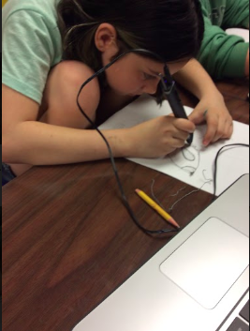
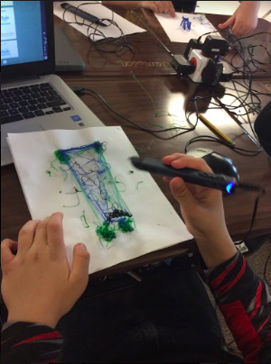
Redefining Learning: Integrating technology into the curriculum
Dr. Cindy S. York, PhD
Associate Professor

Slide 2
Technology
Standards
Learning
Teaching
Assessment
Curriculum

Slide 3
Distance
Learning
Digital
Literacy
Flipped
Classroom
Improved Engagement
Classroom Management
Technology
Information
Access
Differentiated learning
Critical
Thinking
Communication
Collaboration

Slide 4
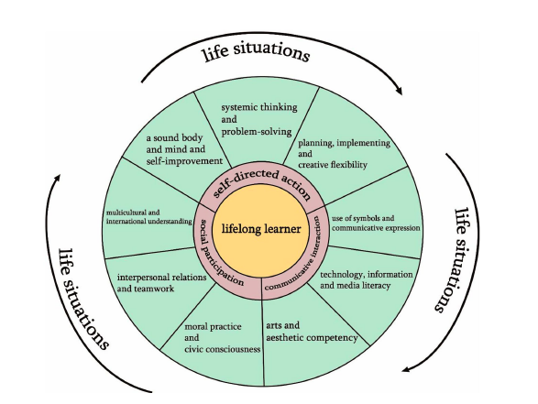
Advancing 21st Century Competencies
in Taiwan

Slide 5
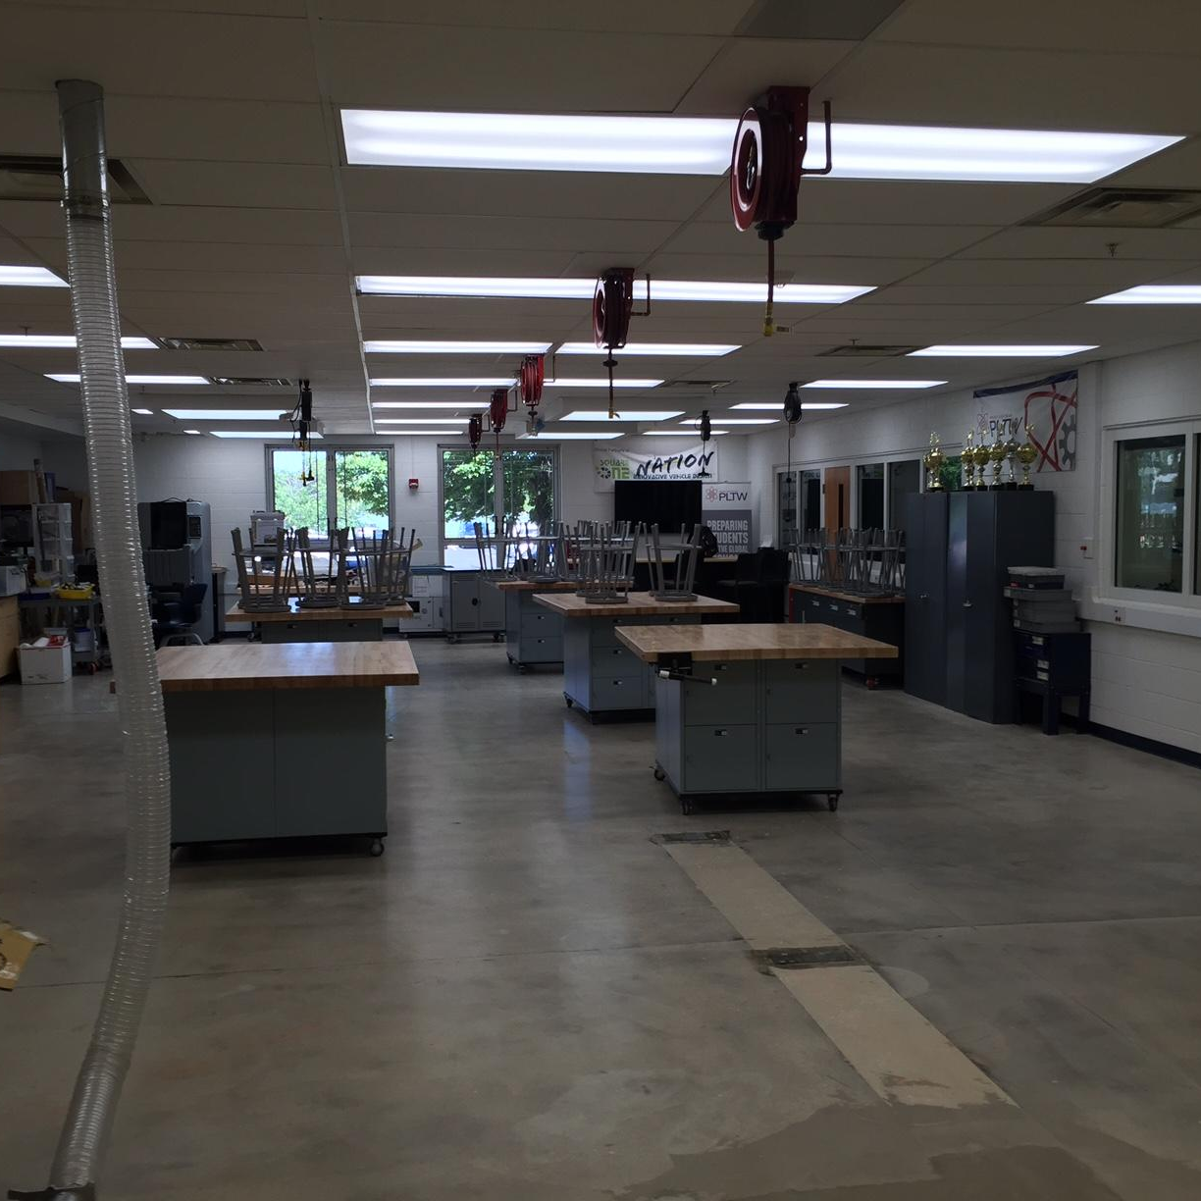
The K12 Makerspace
"A makerspace is an environment or facility that provides resources, materials, and equipment for students to conceive, create, collaborate, and learn through making" (USDOE, 2016).

Slide 6
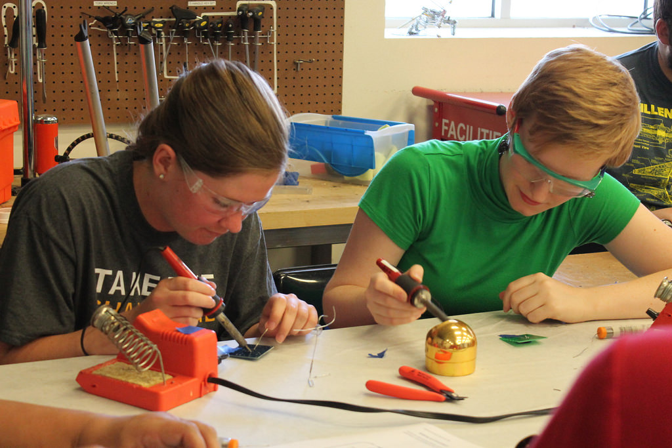
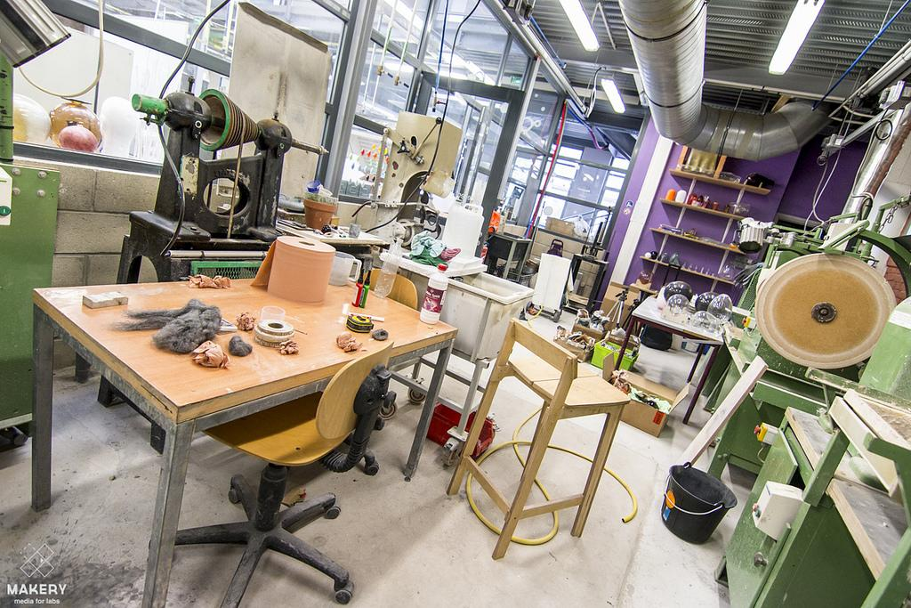
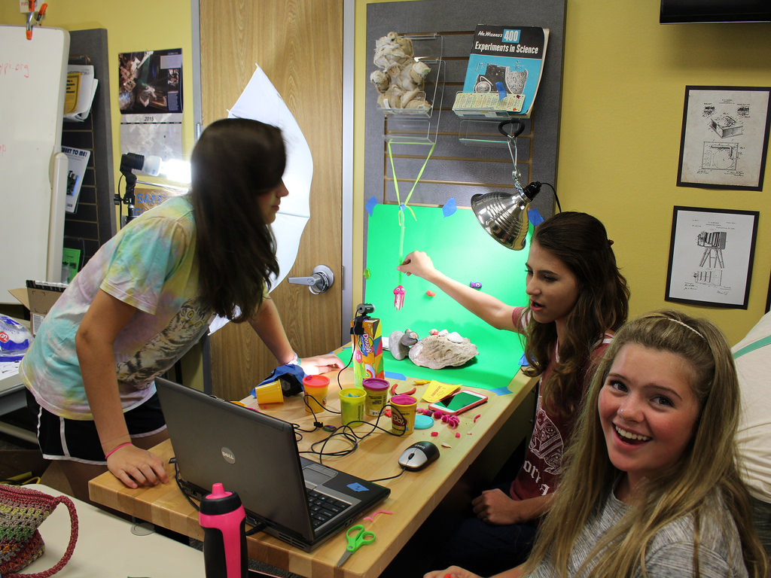
It’s not what’s in a makerspace, it’s what you do with the space.
Photo by San José Library / CC BY
Photo by Makery Media for labs / CC BY
Photo by Harris County Public Library / CC BY

Slide 7
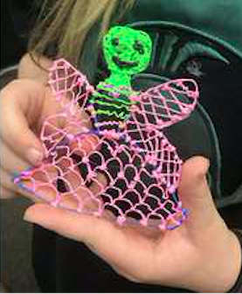
4th & 5th Grade Science Standards Next Gen Science Standards, middle school life science
Build-a-Bug Workshop (Dousay & Weible, 2019)
lesson on biomes, genetics, and heredity
students were asked to design an insect for a specific ecosystem, real or imagined, designing their bug in a planning grid and/or sketching a bug design on paper with colored pencils.
Punnett square analysis of their bug designs for dominant and recessive traits
3Doodler pens were provided to students to experiment with two dimensional (2D) versus three dimensional (3D) drawing to foster creative ability.
Video reflection via Flipgrid (discuss biome, traits,

Slide 9
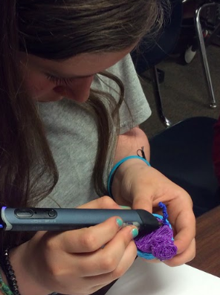
Assessment
Science Standards (explanation of the bug’s traits and fit into biome)
Language Arts Literacy Standards (Flipgrid reflection)
Creativity (2D vs 3D, originality, imaginary vs real)

Slide 10
Resources
Dousay, T. A., & Weible, J. L. (2019, in press). Build-A-Bug Workshop: Designing a learning experience with emerging technology to foster creativity. TechTrends.
Next Gen Science Standards, middle school life science https://www.nextgenscience.org/topic-arrangement/msgrowth-development-and-reproduction-organisms
Glenbrook South High School Makerspace
https://tinyurl.com/yb9pg3ut
Invent to Learn Resources
http://goo.gl/6aob3o
Bringing the Maker Movement to your Classroom
https://goo.gl/AgnlVB
Crowd Sourced Maker Education Bibliography
https://goo.gl/BgPujO
http://www.makerspaceforeducation.com

