Slide 2
Enhance your mathematics classroom using active learning and technology
Dr. Angie Hodge Dr. Cindy S. York
Northern Arizona University Northern Illinois University
March 15, 2019
Notes:
What is Web 2.0?

Slide 3
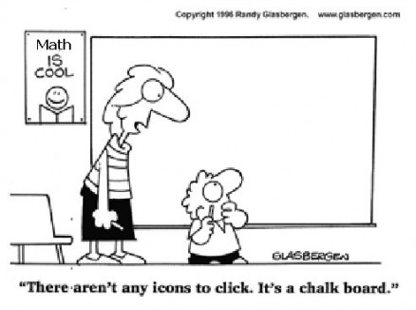

Slide 4
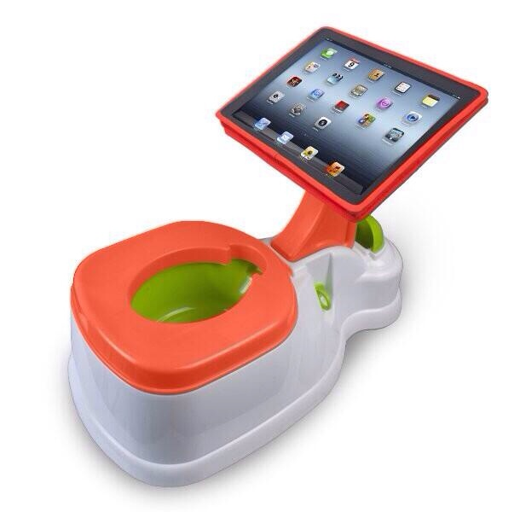

Slide 5
Defining Active Learning

Slide 6
How many of you use TECHNOLOGY in the classroom?

Slide 7
How many of you put the technology in your students’ hands?
Notes:
Are you using the technology or are your students using the technology?

Slide 8
Using Technology vs. Integrating Technology
Notes:
Are you using the technology or are your students using the technology?

Slide 9
Why are you NOT using technology in your classroom?
Notes:
For those of you who don’t use technology in the classroom -

Slide 10
How do you use technology in the ACTIVE classroom?
Notes:
For those of you who do use technology in the classroom

Slide 11
Why should you use technology in the classroom?
Notes:
Communication
Collaboration
Students are using it already

Slide 12
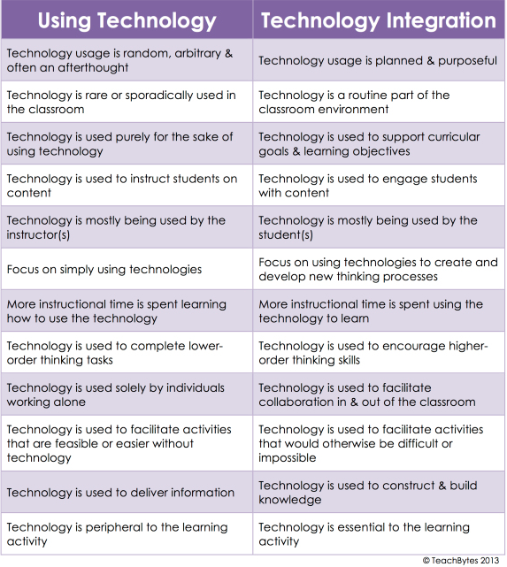
Notes:
TeachBytes 2013
Integrating = invisible. As common as the pencil/paper vs chalk/slate

Slide 13
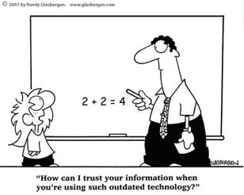

Slide 14
Length of a Ladder
A ladder (green) is needed to reach a wall (blue). There is a fence in front of the wall (red) at a distance "dtowall" from the wall. Move point E to investigate what is the shortest length of a ladder needed to reach the wall. Moving slider "fence" will change the height of the fence.
Notes:
2.83
But what did I learn. How do we make this an IBL problem?

Slide 15
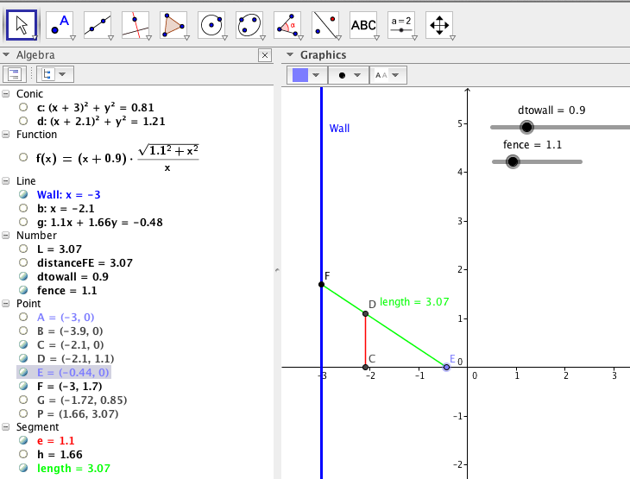

Slide 16
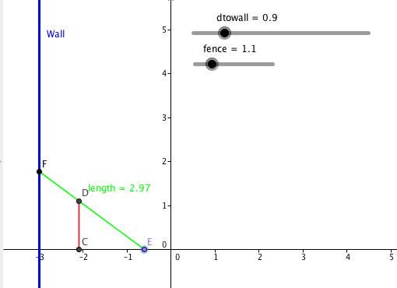

Slide 17
What did I learn?
Did I learn?
How do we make this an ACTIVE problem?

Slide 18
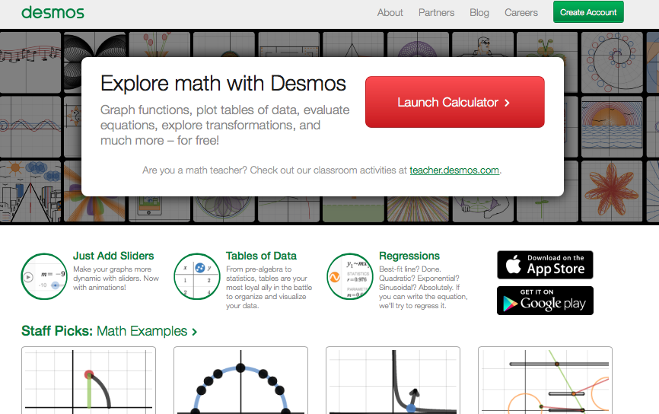

Slide 20
Discussion
What other activities do you do with active learning and mathematics that might be enhanced with technology?

Slide 22
How many of you are COMFORTABLE using technology in the classroom?

Slide 23
How many of you are taking/teaching a class utilizing Active Learning?

Slide 24
How would you rate your comfort level using technology in the classroom?
Very Comfortable
Comfortable
Uncomfortable
Painful

Slide 25
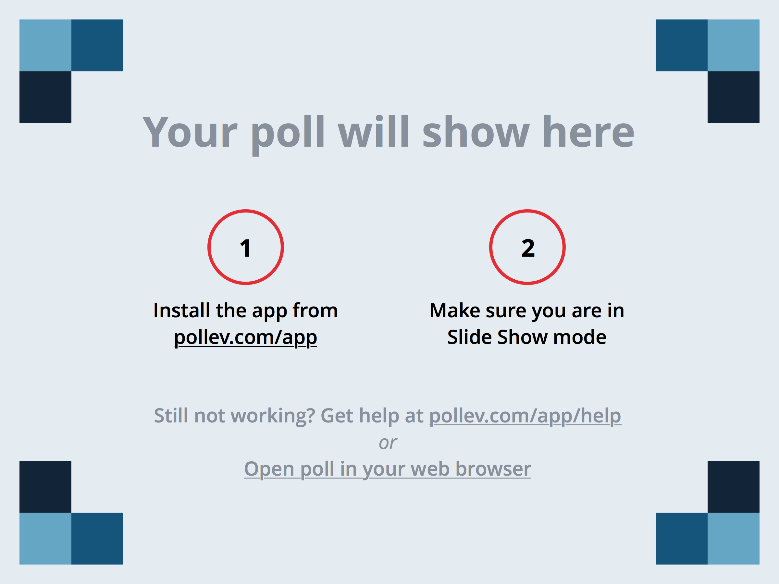
Notes:
How would you rate your comfortability using technology in the classroom? https://www.polleverywhere.com/multiple_choice_polls/HkNzBOpbONWe9ho

Slide 27
Resources Website
https://sites.google.com/site/cindyyork

Slide 28
Using Technology
The Learning Goal
Flexible Technology
Get Messy
Social Interaction
What else should be on this list?

Slide 30
Communication
Collaboration

Slide 31
Examples for Collaboration
Construct Knowledge
Google Drawing
Gliffy.com
Padlet.com

Slide 32
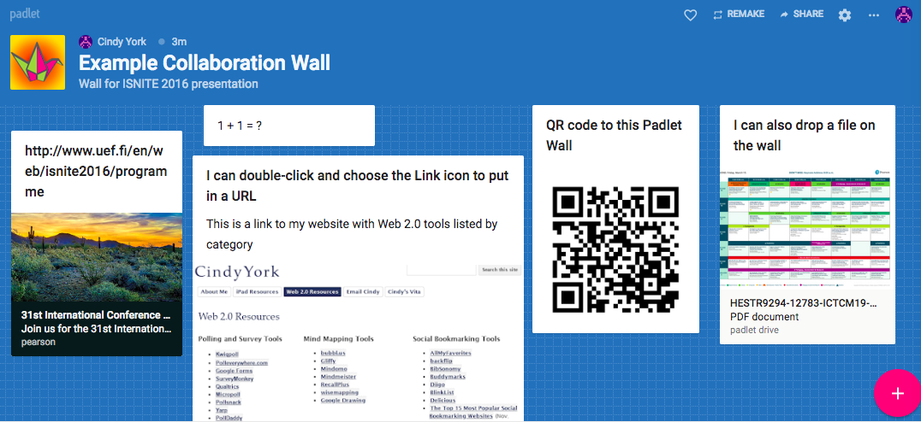
http://padlet.com/cindyyork/k8aiagdcgmia

Slide 33
Examples for Communication
Begin Inquiry
Ask Questions
Gather Info
Diigo – Bookmarking tool
Blogger.com http://iblmathandtechnology.blogspot.com
Google Forms
Notes:
Frontloading: Building prior knowledge
Making connections
Setting a purpose
Developing interest
Getting students hooked!
Ask Questions
Posing relevant, inter-connected questions
Facilitating students’ ability to ask questions that connect to their lives
Gather info:
Collecting information from all types of sources
Interviewing, surveying, and creating new data
Asking more questions
Learning how to document the data

Slide 34
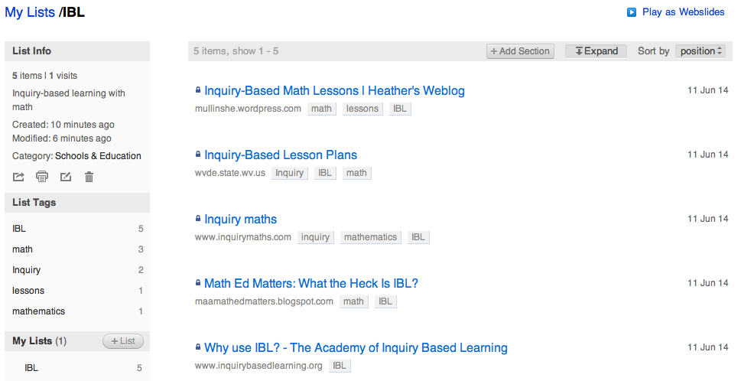
Using Diigo to Begin Inquiry

Slide 35
Using Blogger to Ask Questions
http://iblmathandtechnology.blogspot.com
Notes:
https://www.blogger.com/blogger.g?blogID=7018731543330653135#allposts

Slide 36
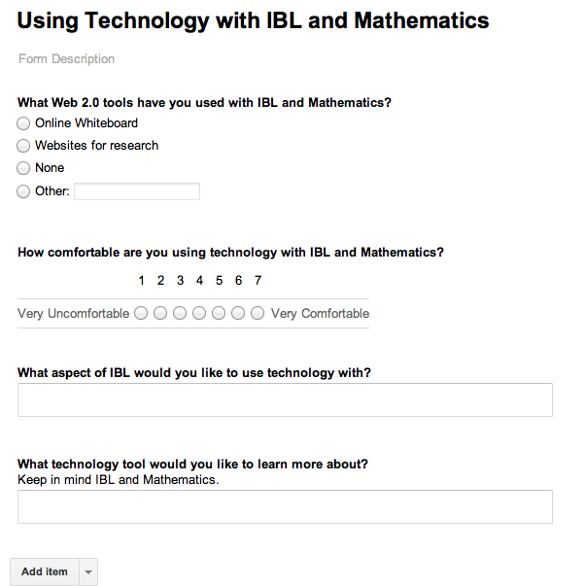
Using Google Forms to Gather Info
To fill out the survey: http://tinyurl.com/IBLMath

Slide 37
Hands-on Time

Slide 38
Dr. Angie Hodge, PhD
Angie.Hodge@nau.edu
Dr. Cindy S. York, PhD
cindy.york@niu.edu

