Slide 1
A One-to-One iPad Intervention: Student Perceptions Grade 2-4
Cindy S. York
Patrick R. Lowenthal
Hayley J. Mayall
Kathleen B. Fabrikant

Slide 2
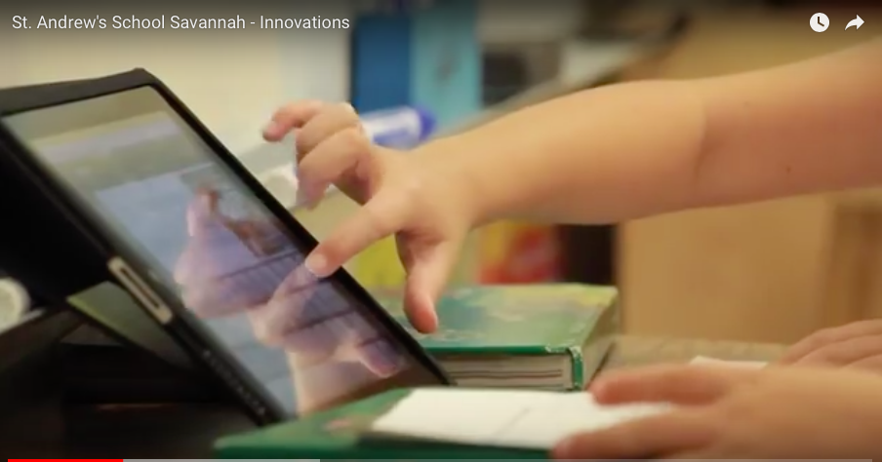

Slide 3
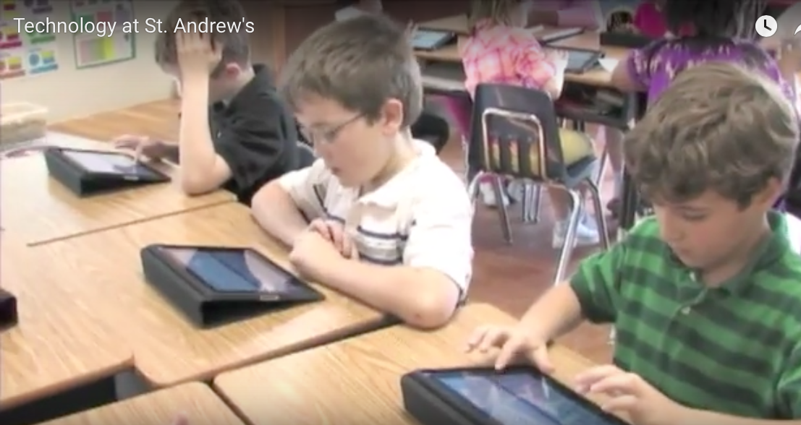
Overview
Educational Technology Initiatives
One-to-One
Mobile Technologies
Notes:
Introduction
For decades, educators have been interested in the potential of computers to improve student learning (Cuban, 2001). In fact, one of the first educational technology initiatives occurred in 1986, almost 30 years ago, when the Apple Classrooms of Tomorrow collected data on “high-access-to-technology classrooms” (Dwyer, Ringstaff, & Sandholtz, 1990, p. 1). One limitation with early classroom technology initiatives like the Apple Classrooms of Tomorrow was that the technology could not leave the classroom and at times was limited to a dedicated computer lab. Thus, students lost access to the computers and their purported benefits as soon as they left the classroom. Technological advances have lowered the prices and increased the mobility of computers; these changes have addressed some of the issues with previous educational technology initiatives and in turn have helped a growing number of schools and districts implement one-to-one initiatives (i.e., initiatives that put a mobile computing device in the hands of each student). As one-to-one initiatives have increased, researchers have tried to document how giving each student a mobile computing device can improve the educational experience and at times increase student learning. For instance, some research has shown how these devices can increase student engagement (Looi et al., 2011; Milman, Carlson-Bancroft, & Boogart, 2012) and student ability (Lin, Shao, Wong, Li, & Niramitranon; 2011). But to be successfully adopted--and therefore eventually add value to the classroom and ultimately influence student learning--we contend that teachers and students must see the educational value and benefit of mobile devices in classroom. Unfortunately, though, even with millions of tablets being purchased for classrooms (see Lytle, 2012; Ogg, 2012), there is still very little research on what students, specifically elementary-aged students, think of using mobile devices to learn (see Hwang & Tsai, 2011; Wu et al., 2012). Therefore, we set forth to investigate elementary-aged students’ perceptions of using mobile devices, specifically iPads, in the classroom.

Slide 4
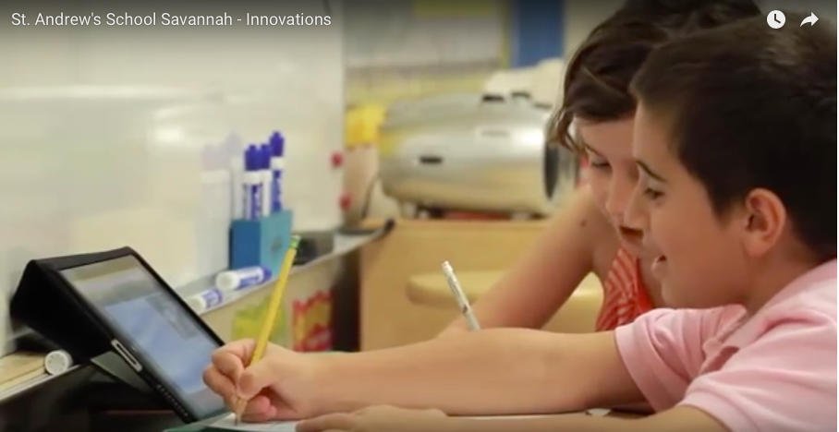

Slide 5
Purpose
Overarching Study - School Overview
Administrators
Teachers
Parents
Students
To investigate elementary-aged students’ perceptions of using mobile devices, specifically iPads, in the classroom.
Notes:
The participants in this study attended a PK-12 independent college preparatory school in the southeastern United States. This school was selected for this study because it was one of the first schools in the United States to implement a one-to-one iPad initiative school-wide. iPads were purchased and distributed to all students, administrators, and faculty at the school. The school had 416 students, 86.5% of which were Caucasian.

Slide 6
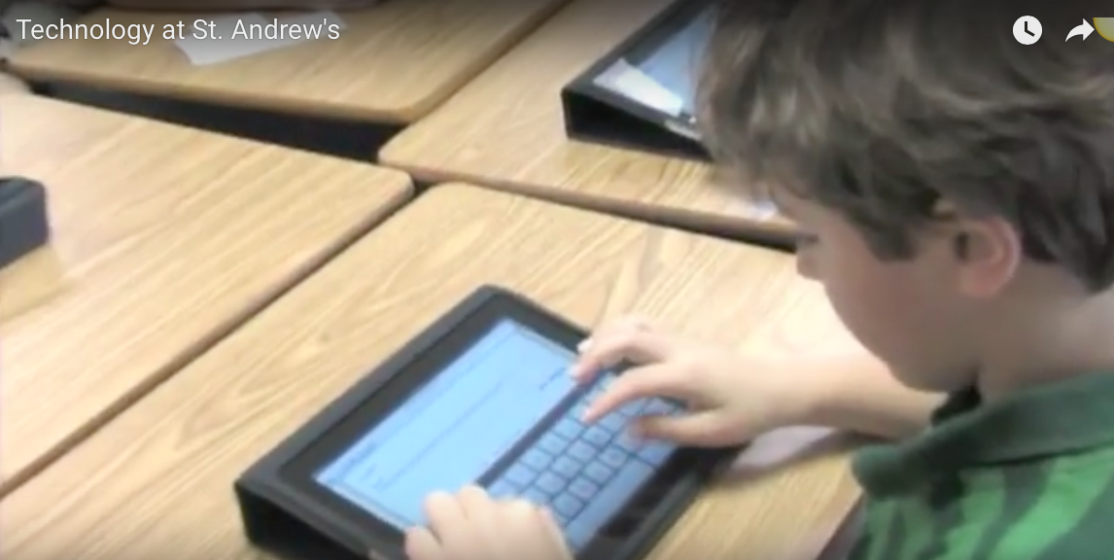

Slide 7
Survey
How do you feel about using iPads in school?
Using iPads really helps me with my school work:
My iPad helps me learn new things:
My iPad helps me with my homework.
I like to use my iPad outside of school:
My iPad makes learning more fun:
My iPad helps me understand my school work better:
I use my iPad in school the most for (write below how you use it the most)
Notes:
Faced with the increased use of iPads in the elementary classroom and the overall lack of research specifically on elementary students uses of these devices, we set forth to explore students’ perceptions of using iPads for educational purposes. The following research question guided our inquiry: What are elementary-aged students’ perceptions of using iPads in school? We created a survey to investigate this overall question. A survey was constructed consisting of 10 questions. The first two questions were demographic in nature; the next six questions utilized an age appropriate 3-point Likert-scale using a smiling face (positive), neutral face, and frowning face (negative) and focused on students perceptions of using iPads. The last question was an open-ended question. After students completed the survey, the data were entered into a spreadsheet and imported into SPSS for analysis.

Slide 8
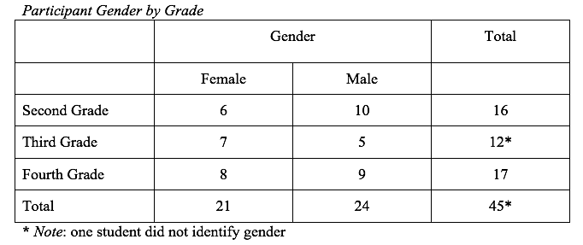
Participants
Notes:
All 85 students in the second, third, and fourth grades were invited to participate in the study; 16 second graders, 13 third graders, and 17 fourth graders, for a total of 46 students actually ended up participating in the study (54% response rate; see Table 1).

Slide 9
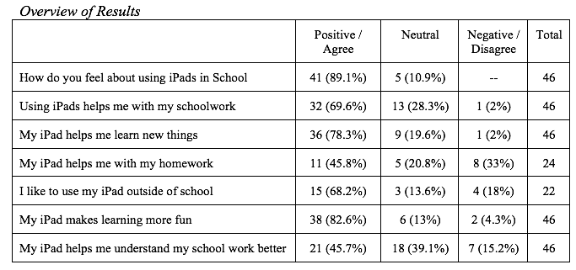
Results
Students’ Perceptions of iPads
Notes:
Results
Students’ Perceptions of iPads
The majority of students in this study felt good about using iPads in school; in fact, 89.1% felt positive and no students felt negative about using iPads in school (see Table 2). Overall 82.6% of the students also reported that they thought that iPads made learning more fun. However, when asked if iPads helped them learn new things, the students response was still overall positive (with 78.3%) but the number of neutral responses increased to 19.6%. The overall positive perception of using iPads decreased more when asked how they liked using iPads outside of school (68.2% reporting a positive perception) and even more when asked how iPads helped them with homework--with less than half of students (45.8%) reporting a positive experience.
Table 2

Slide 10
Results
*Note: The one person who did not identify his/her gender is not included in this table
Notes:
Differences of Perceptions Across Gender and Grade Level
Crosstab analyses were then used to identify differences in perceptions of iPads by grade or gender. When looking at the question about whether iPads helps students understand school work (i.e., My iPad helps me understand school work better), there was no difference between gender across all grades but there was a difference between grade level. The fourth grades students felt neutral or negative (n=15) more often than the second grade (n=5) and the third grade (n=5) students.
The next prompt basically asked students the degree to which their iPad helped them understand their school work better. Positive and negative responses were very similar across grades between females and males, however there was more variance across gender and grades for those who selected neutral. For instance, while second grade males selected neutral (n=3) more than females (n=1), third grade females (n=3) and fourth grade females (n=6) selected neutral more than third grade males (n=1) and fourth grade males (n=4). The bigger differences, though, were not between gender but between grade. For instance, while the majority of second graders (n=11) and third graders (n=7) responded positively to the question about their iPad helping them understand their schoolwork better, more than half of fourth graders responded neutrally (n=10) or negatively (n=5).
Table 3

Slide 11
Results
*Note: The one person who did not identify his/her gender is not included in this table
Notes:
Then when looking at how students felt about iPads helping them learn new things (i.e., My iPad helps me learn new things), we did not find significant differences between gender across all grades levels--but there was some disparity between fourth grade females and males. For instance, 7 fourth grade females responded positively to this question compared to only 4 fourth grade males. At the same time, when looking at differences of perceptions across grade level, the fourth graders once again responded neutrally or negatively to this prompt (n=6) more than second graders (n=1) and third graders (n=3).

Slide 12
Results
*Note: The one person who did not identify his/her gender is not included in this table
Notes:
The next two questions focused on using the iPad for homework (i.e., My iPad helps me with my homework) and outside of school (i.e., I like to use my iPad outside of school). When this survey was administered, the researchers were unaware that the second and third graders were not allowed to take their iPads home; however, some of these students still chose to answer those prompt as if they could (see Table 3). But when focusing on just fourth graders and gender differences on how using iPad helps with homework, more males responded positively (n=4) than females (n=2) but then more females responded neutrally (n=4) than males (n=1). But then when asked how they liked using iPads out of school, both females (n=7) and males (n=6), for a total of 76.5%, reported positive perceptions

Slide 13
Results

Slide 14
Results
Notes:
The last question was an opened question that asked students to share what they used their iPad the most for in school. The responses were collected and coded as being in one of following categories: communication, games/fun, general, language arts, mathematics, research, science, social studies, and spelling. A frequency table for that data distribution is shown in Table 4.
Table 4

Slide 15
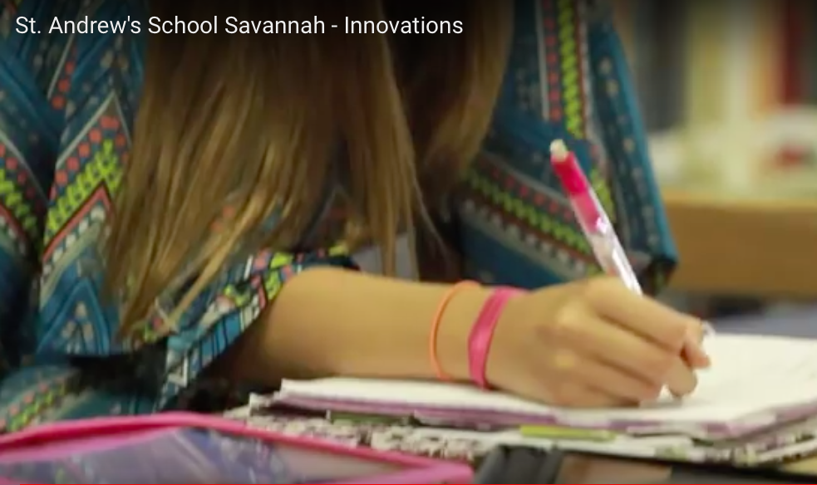

Slide 16
Discussion
Positive Perceptions
Homework
IPad use
Novelty or Tool?
Notes:
Discussion
The results suggest that the elementary-aged students in this study as a whole had positive perceptions of the instructional use of iPads in their classroom. However, the data also suggests that the second and third graders had more positive perceptions and therefore likely a better experience than the fourth graders in this sample. Perhaps the most likely explanation for this difference in perception could be how the iPads were used in each grade. For instance, fourth graders tended to have more homework and a greater focus on academics than the second and third graders. It could be that this teacher simply used the iPads more for academic purposes than the teachers in the other grades.
While the fourth graders were the only students that could take their iPads home (which they reported that they liked), they seemed to be split on how useful iPads were with completing homework; it could be that they did not like having to use the iPad for homework or even that their teacher had not identified useful ways to assign homework tied to the iPad. Another possible explanation could simply be due to age. Fourth graders could already have had prior experience with computers and/or laptops and therefore were not as susceptible to the novelty of this new technology. For instance, Crichton et al. (2012) conducted a study where they found that elementary and middle school students responded better to technology integration than high school students. More specifically, in our study, the second and third grade students (64.3%) felt the iPads helped with schoolwork much more than the fourth grade students (11.8%). Looi et al. (2011) found a similar result with mobile phone use in third grade classrooms. In that study, “around 80% of the students thought that the . . . phone helped their learning in and out of class” (Looi et al., 2011, p. 280). The context of each one-to-one integration is different and situational factors (e.g., how the teachers were trained and in turn integrated the mobile devices into the classroom) likely influence student perceptions of mobile devices. Therefore additional research needs to be conducted to see how age influences students’ perceptions of using mobile devices for instructional purposes.
The only notable difference between gender between third grade females and males when it came to using iPads for homework. As a whole though there were not overall big differences across gender. In fact, female students were as a whole more positive or neutral--or to put it another way, less negative--than male students. Additional research though needs to be conducted to investigate the inconsistencies in grade and gender.

Slide 17
Videos
YouTube videos about St. Andrews:
https://youtu.be/0OEcb5tXzpQ
https://youtu.be/ngkSIw7uIhM
Notes:
3:13 – talk about ipads

Slide 18
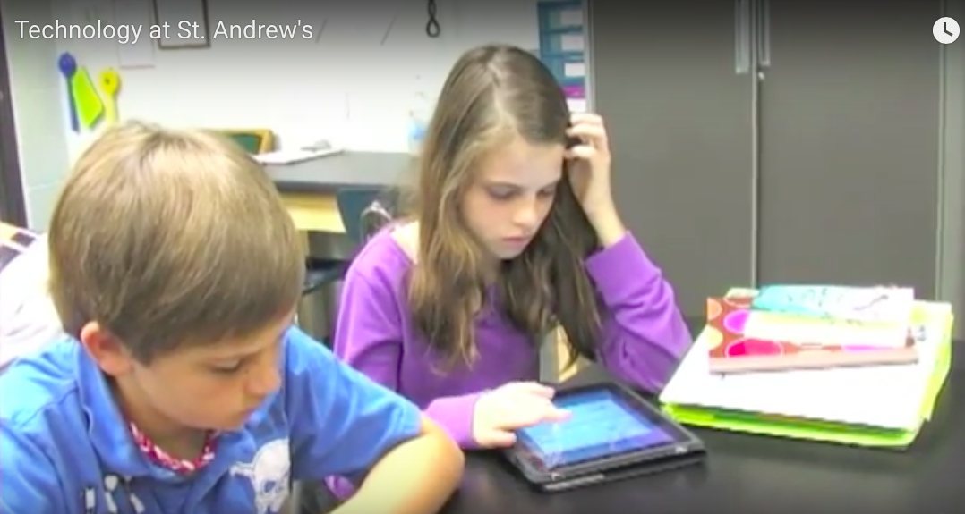
Conclusion
Is the technology aiding in the engagement of students with the instructional material and in turn, student learning, or is the newness of the technology driving the engagement?
Limitations
Small study size
One school
Notes:
Conclusion
We were not surprised that students overall had positive perceptions of using iPads. However, we question as others have if the technology is aiding in the engagement of students with the instructional material and in turn student learning, or if the newness of the technology is driving the engagement?
The small population of this study limits our ability to generalize the results. However, our intent at this stage was simply to get a sense of what elementary-aged students think of these devices at this one specific school that can then help guide additional faculty development efforts. Additional studies of the use of iPads and other mobile technologies in classroom applications are increasingly necessary if the field of educational technology is to keep pace with the advent of new devices and ways of communicating in our schools.
The fact that the second and third graders were not allowed to take their iPads home makes it difficult to discuss their perceptions of using iPads for certain things such as homework. However, we recognize the risks of sending young students home with devices worth hundreds of dollars and respect any school’s decisions for putting restrictions on how mobile devices are used.
An overwhelming majority of the students agreed that the iPads made learning more fun. This might be due to the novelty of the new technology. However, the teachers at the school emphasized that the iPads were seen as another instructional tool with specific purposes. Exploration time at centers was encouraged, and math apps in one classroom were routinely used as one part of the lesson. The teacher was able to track the progress of each student in the math group, making differentiation quick and accurate. But additional research needs to be conducted to identify additional evidence-based practices to guide teachers use of mobile devices in the classroom.

Slide 19
Future Research
Our second, third, and fourth graders are now eighth, ninth, and tenth graders.
If we give the survey to them again next year, it’ll be interesting to see longitudinally how they have changed. The technology is no longer new and they’ve been using it for 6 years.
Notes:
Longitudinal research is needed that follows students across elementary school to see how their use and perceptions of mobile devices changes as they get older, school gets academically more difficult, and the newness of the devices wears off.

Slide 20
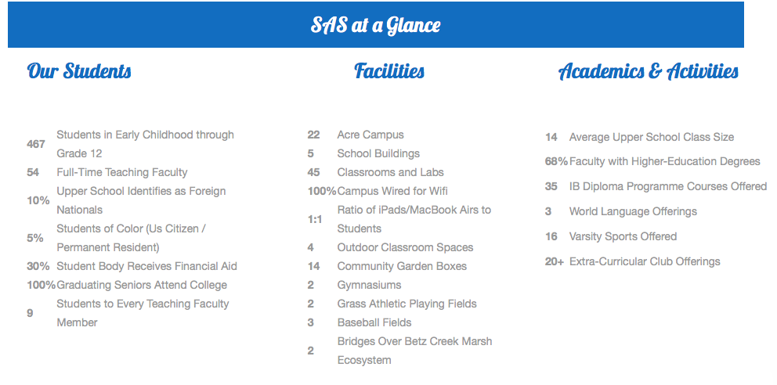

Slide 21
For More Information
cindy.york@niu.edu
patricklowenthal@boisestate.edu
hmayall@niu.edu
kathleen.fabrikant@armstrong.edu

