Slide 2
Integrating Technology into an Inquiry-based Mathematics Classroom
Dr. Cindy S. York Dr. Angie Hodge
Northern Illinois University University of Nebraska Omaha
18th Annual Legacy of R. L. Moore – IBL Conference
June 27th, 2015
Notes:
What is Web 2.0?

Slide 3
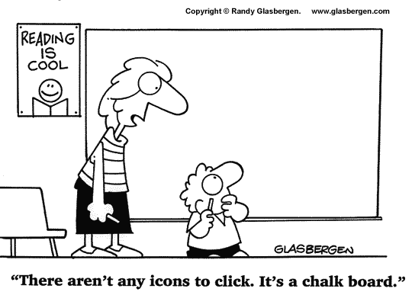

Slide 4
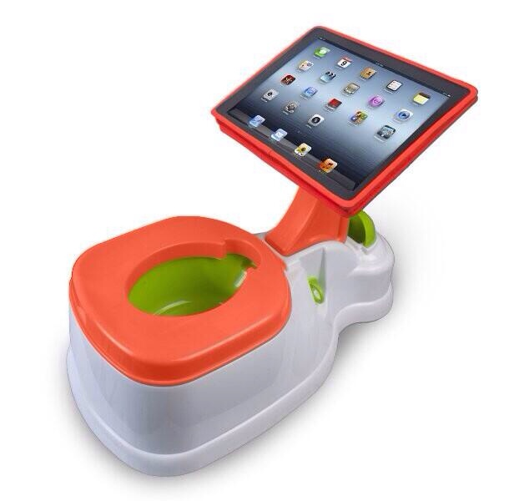

Slide 5
How many of you use TECHNOLOGY in the classroom?
Notes:
Are you using the technology or are your students using the technology?

Slide 6
How many of you put the technology in your students’ hands?
Notes:
Are you using the technology or are your students using the technology?

Slide 7
Using Technology vs. Integrating Technology
Notes:
Are you using the technology or are your students using the technology?

Slide 8
Using Technology
Why are you NOT using technology in your IBL classroom?
Notes:
For those of you who don’t use technology in the classroom -

Slide 9
Using Technology
How do you use technology in the IBL classroom?
Notes:
For those of you who do use technology in the classroom

Slide 10
Using Technology
Why should you use technology in the classroom?
Notes:
Communication
Collaboration
Students are using it already

Slide 11
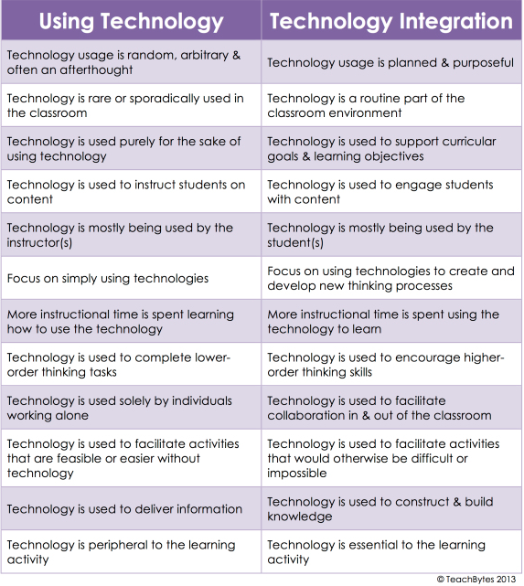
Notes:
TeachBytes 2013
Integrating = invisible. As common as the pencil/paper vs chalk/slate

Slide 12
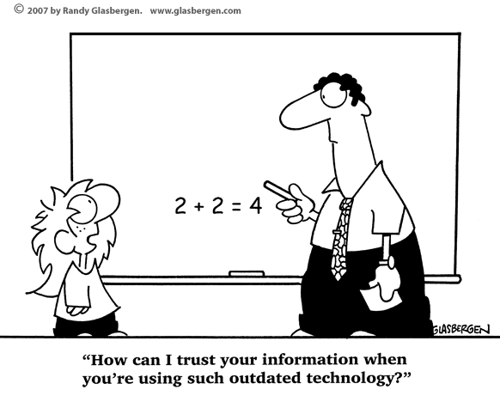

Slide 13
Notes:
I was given this tool/problem as an example of SW students are using to help them in class.

Slide 14
Length of a Ladder
A ladder (green) is needed to reach a wall (blue). There is a fence in front of the wall (red) at a distance "dtowall" from the wall. Move point E to investigate what is the shortest length of a ladder needed to reach the wall. Moving slider "fence" will change the height of the fence.
Notes:
2.83
But what did I learn. How do we make this an IBL problem?

Slide 15
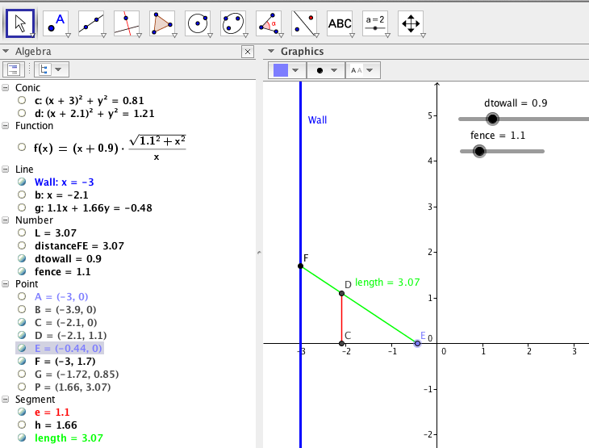

Slide 16
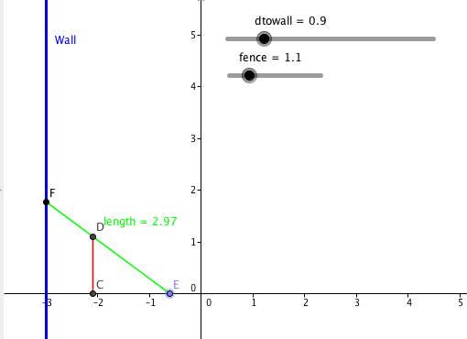

Slide 17
What did I learn?
Did I learn?
How do we make this an IBL problem?

Slide 18
Discussion
What other activities do you do with IBL and mathematics that might be enhanced with technology?

Slide 19
Dr. Cindy S. York, PhD
cindy.york@niu.edu
Dr. Angie Hodge, PhD
amhodge@unomaha.edu

Slide 20
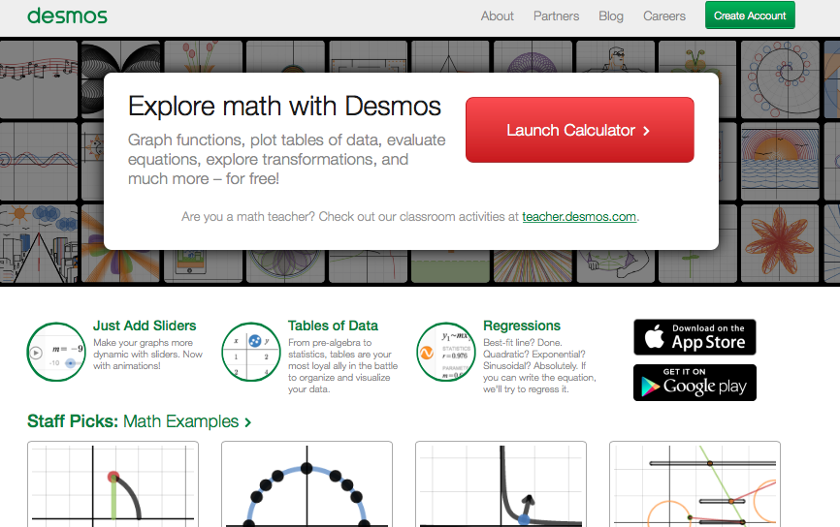

Slide 21
Examples for Collaboration
Construct Knowledge
Google Drawing
Gliffy.com
Padlet.com

Slide 22
http://padlet.com/cindyyork/k8aiagdcgmia

Slide 23
Resources Website
https://sites.google.com/site/cindyyork

