Slide 1
Technology Integration in Mathematics Classrooms: Faculty Competencies and Challenges
Dr. Angie Hodge, University of Nebraska Omaha, USA
Dr. Cindy S. York, Northern Illinois University, USA
Dr. Hayley J. Mayall, Northern Illinois University, USA
ISNITE 2016

Slide 2
Who we are…
Dr. Angie Hodge, PhD
amhodge@unomaha.edu
Dr. Cindy S. York, PhD
cindy.york@niu.edu

Slide 3
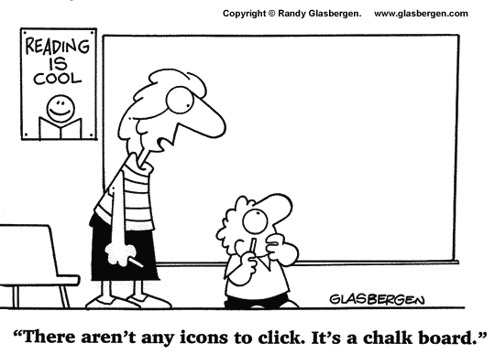

Slide 4
Impetus for Study
Methods used when typically teaching mathematics
Technology use by mathematics faculty
Is it true that technology is not used much to engage learners, even in the classrooms that were set up to engage student learners?
Were there differences in faculty competencies that led to increased use of technology?

Slide 5
Purpose
The purpose of this exploratory study was to collect data on three items:
perceptions of teacher comfort levels regarding the use of technology,
teacher knowledge of the technological tools available to them, and
any challenges that teachers have encountered in using technology in the mathematics classroom.

Slide 6
Demographics
Participants
How chosen (Inquiry-based learning)
Emails sent (~1000)
106 completed survey and gave consent
Age range
28 – 84 years
Years teaching range
10 years or less = 26%
11 years or more = 74%
Gender
Male = 66%, Female = 34%
26 survey questions

Slide 7
Perceptions of Competency
What do you believe to be your computer proficiency level?
What is your comfort level with using computers during your teaching?

Slide 8
Computer proficiency levels with using technology while teaching
How would you rate your general computer/technology proficiency level? | Percentage
No ability | 0%
Poor | 1%
Moderate | 13%
Good | 31%
Very Good | 42%
Expert | 12%

Slide 9
Comfort levels with using technology while teaching
What is your comfort level with using computers/technology during teaching | Percentage
Not comfortable at all | 3%
Mildly comfortable | 16%
Comfortable | 35%
Very comfortable | 35%
Extremely comfortable | 11%

Slide 10
Faculty Use
Which of the following technologies do you use while teaching? (Not for creating assignments, posting on the computer, emailing, etc., but while actually teaching).
Please describe how you use technology in your classroom while teaching.

Slide 11
Technology tools available versus used
 | What technologies are available to you in your classroom? | Which technologies do you use for teaching?
Electronic projector (with computer) | 89% | 69%
Computer / laptop | 78% | 75%
PowerPoint software | 75% | 20%
Document Camera | 73% | 61%
Excel software | 68% | 22%
Math software | 64% | 53%
DVD, VCR, Filmstrip | 44% | 9%
Smartphone | 30% | 14%
Smartboard | 22% | 12%

Slide 12
How are they using technology?
“Use clickers to engage students in discussion based questions where they discuss until they arrive and agree on an answer. Use Excel in Stats classes to collect/analyze data during class. Use java applets to explore ideas related to Statistics (e.g. changing sample sizes and seeing how that changes averages or standard deviations). Use document camera to project student work.”

Slide 13
How are they using technology?
“Well, that's a big question! Generally, I assign tasks where students use mathematical software to explore things that either allow them to create conceptual knowledge or make conjectures (and hopefully prove them). Examples: In geometry I'll have the students use GeoGebra to make conjectures about Euclidean, hyperbolic, or projective geometry. (I typically give them a worksheet with some task to explore, with open-ended questions to help guide them.) In linear algebra I will create a Mathematica lab to have them, say, explore the geometric nature of eigenvalues and eigenvectors. Sometimes the software is merely a platform for them to explore, using code I already created for them. Other times my intention is for them to learn how to use the software as a tool for their own explorations, where they create the code to investigate their ideas. “

Slide 14
How are they using technology?
“In class, I often use programs and websites such as Mathematica and Desmos to visualize concepts that we're discussing in class. I also have students project their solutions to homework problems from the classroom computer or document camera.”

Slide 15
Challenges
Time
Technology reliability (when the tech doesn't work)
Technology proficiency (learning curve)
Technology is not a seamless integration with the content being taught
Lack of student hardware (laptops, phones)
Poor infrastructure and support
Distraction for the students

Slide 16
Implications
Went in not expecting such high levels of proficiency and comfort level with technology
Now further investigation of the data will take place to see if there are any correlations or predictive value in the data

Slide 17
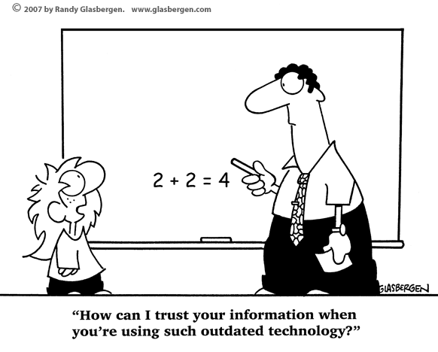

Slide 18
Unanswered Questions
What is participants’ definition of “use”?
Are they engaging with the technology or just showing pictures?
How many are using technology to make the class more interactive or help students learn?

Slide 19
Technology for Collaboration & Communication
Construct Knowledge
Google Drawing
Gliffy.com
Padlet.com

Slide 20
http://padlet.com/cindyyork/z7r8u0x0p3ck

Slide 21
Resources Website
https://sites.google.com/site/cindyyork

Slide 22
How many of you use TECHNOLOGY in the classroom?

Slide 23
How do you use technology in your classroom?

Slide 24
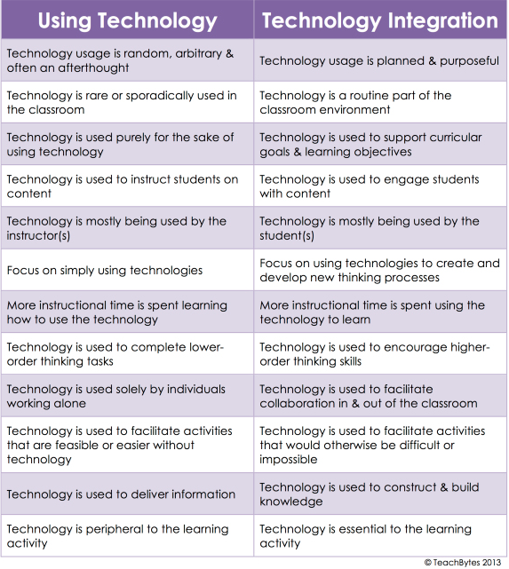
Notes:
TeachBytes 2013
Integrating = invisible. As common as the pencil/paper vs chalk/slate

Slide 25
Dr. Angie Hodge, PhD
amhodge@unomaha.edu
Dr. Cindy S. York, PhD
cindy.york@niu.edu
Dr. Hayley J. Mayall, PhD
hmayall@niu.edu

